Slide 1
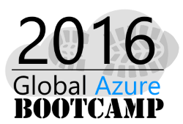
45 Azure Services in 45 Minutes
Matt Davies
Principal Consultant, Readify

Slide 2
Seriously?
Notes:
Yep.
We get asked all the time about new services in Azure – the pace of innovation is genuinely hard to keep up with. I’m going to try and cover services you need to know about if you’re just getting started, as well as some of the more recent ones the veterans might not have had a chance to explore yet.
If you can’t keep up, don’t worry, I’ll send you the slide deck, but it’s probably out of date by the time you have a chance to open it on your machines.

Slide 3
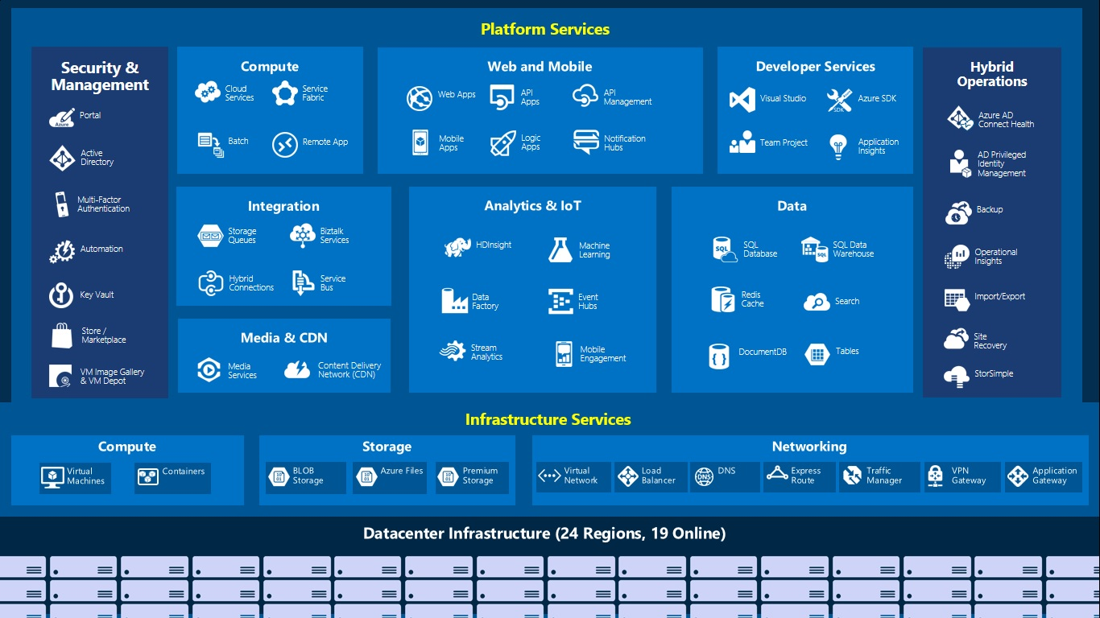
Notes:
If you can count really, really fast you’ll see there’s 58 services here. This was the most recent diagram we could find, and it doesn’t even include recent releases like Azure functions.
I’m going to take a selection for each category you see here. The first and second are must knows, the next is intermediate and the last few are advanced.
What do you want to get out of this – at least understand the first one or two services in each group.

Slide 4
Compute

Slide 5
Virtual Machines
Persistent, dedicated resources
Full control over your installed apps and OS
Power and flexibility
At the cost of high maintenance
Difficult to scale automatically
1
Notes:
First thing you think of when you’re new to cloud. Equivalient of an on-premises Virtual Machine, with a dedicated amount of resources. You can spin these up at the click of a button.
Gavin’s point – architecting for the cloud.

Slide 6
Cloud Services
Transient, dedicated resources
Run a custom .NET app you provide on startup
Azure will restart the app if it fails
Easily scalable to multiple instances
Still quite low level – you write everything you need in your .NET code
2
Notes:
One of the earliest Azure services.
Hard to scale out multiple instances on a VM because you need to make an image for each and it gets tricky when you want to make changes.

Slide 7
Azure Containers
Docker containers as a service
Existing tooling
Handles replication, scaling, isolation, deployment
3
Notes:
Containers – isolated deployable units containing both core OS libraries and configuration as well as an application you want to deploy.
Clever things like projecting through copies of files in the host OS until containers differ, at which point they get their own copy.

Slide 8
Service Fabric
Microservice development services and hosting
In place deployments, auto scaling, health monitoring, service healing
Failover, leader election, state management
APIs that support many of the cross cutting concerns relevant to building microservices
4
Notes:
In GA now

Slide 9
Batch
Programmatically define large scale batch jobs
Ideal for highly parallel tasks e.g. media encoding, image processing, modelling and data analysis
Handles scheduling, scaling and reducing
5

Slide 10
Azure Functions
Event driven compute
Write code that runs on events in any Azure service and a variety of third party services by connecting to existing messaging systems
Bash, PowerShell, Javascript, C#, Python, PHP…
6
Notes:
Shoutout to Martin Abbott on this one!

Slide 11
Web and Mobile

Slide 12
App Services - Web Apps
IIS as a service
Deployments and rollbacks
Autoscaling on a variety of metrics
Deployment slots
Redundancy
Multiple programming languages
7
Notes:
In a couple of clicks (or via JSON in source control if you want to get clever) you can have a fully working IIS website with a bunch of stuff managed for you.
API, Logic, Mobile Apps
.NET, Node, PHP, Python, Java

Slide 13
API Apps
Swagger metadata
Access control via Azure AD, social authentication
Trigger APIs called from logic apps to look for a workflow trigger e.g. search data found
Action APIs, perform actions in response to logic app triggers e.g. send notification
8

Slide 14
Logic Apps
Integrate disparate data sources
Design workflows that execute triggers and then a series of steps
Composable SaaS
Use a gallery of existing APIs or make an API app
9
Notes:
Based upon the activity from your facebook or twitter accounts create a CRM task. Connect your cloud marketing solution to your on-premises billing system.
Can leverage BizTalk for more advanced scenarios.

Slide 15
Mobile Apps
Authentication SDKs for mobile apps
Data access via OData linked to SQL Server, NoSQL, Table Storage, DocumentDB, SaaS APIs
Offline Sync SDK
Push notifications via WNS, APNS, GCM, Notification Hubs
10

Slide 16
Notification Hubs
Managed mobile push notifications
Abstracts away the provider notification systems
Target individuals or segments with millions of users
11

Slide 17
API Management
Full API gateway
Signup, login flows for developers using your APIs
Rate limiting, key management, authentication, documentation
12

Slide 18
Data
Notes:
What just happened? Take a break? No time ☺

Slide 19
SQL Database
Managed relational database
High functional compatibility with SQL Server
Elastic pools of DTUs
Point in time restore
Row level security
Transparent encryption / always encrypted
13
Notes:
Been saying different to on prem sql for years – not as true anymore!
Database throughput unit

Slide 20
Blob Storage
Storage for any text or binary data (object storage)
Can directly serve out files to users
Storage layer behind majority of Azure services
14

Slide 21
Azure Files
File shares backed by blob storage using SMB
Access via Cloud Services and Virtual Machines
Designed for existing applications built without awareness of blob storage APIs
15
Notes:
Mention StorSimple here
Server Message Block protocol

Slide 22
Table Storage
Structured NoSQL data
Partition / row key for lookups
Low cost, simple and extremely high performance for some scenarios
Up to the developer to design applications efficiently
16

Slide 23
DocumentDB
NoSQL database engine
Natively supports JSON
Automatically indexes documents
Uses an SQL language
JavaScript functions
Higher cost for equivalent table storage performance
17

Slide 24
Data Lake
Store any size or type of data in a single place
Dynamically scalable
Explore patterns
Reuse existing technology like U-SQL, Apache Spark, Hive, Hbase, Storm
Azure AD
Analytics
18
Notes:
All data loaded from source systems – nothing is turned away
Stored in a nearly untransformed state
Transformed with a schema applied to fulfil the needs of analysis
Retain all data

Slide 25
SQL Data Warehouse
Different kind of central repository for data
Highly transformed and structured data
Loaded into the warehouse once a use is defined
Dynamically scalable
Highly optimised query performance via T-SQL
19
Notes:
Can turn down the DWU scale on weekends, not running queries etc.

Slide 26
Search
Search as a service
Add search to your apps using a REST API or a .NET SDK
Lucene query syntax
Natural language support
Drill down filters
Crawlers, PDF, Word indexing, scoring, paging
20

Slide 27
Redis Cache
PaaS version of Redis
Azure handles scaling, persistence, performance, configuration
21

Slide 28
Integration
Notes:
What just happened? Take a break? No time ☺

Slide 29
Storage Queues
Basic queue service
Access via HTTP/S
Messages up to 64KB/s
No locking, maximum 7 days in queue
22

Slide 30
Service Bus
Feature rich elastic messaging system
Range of protocols and APIs to access messages
Publish/subscribe pattern
Guaranteed message order
Duplicate detection
Transactions
23

Slide 31
Hybrid Connections
Connect Web Apps and Mobile Apps to on-premises resources behind a firewall
Minimal TCP ports
Limited to apps that use a static TCP port such as SQL server, APIs, custom web services
24
Notes:
Newer technology with some overlap with Service Bus replays. With Service Bus Relays you host a cloud based service which Azure hooks into to forward messages through to the listening application on premises. Limitations like needing to use your own WCF based listener to handle the communications.

Slide 32
Biztalk Services
Out of the box, line of business integration for SAP, Oracle, SQL, PeopleSoft
Route messages using Service Bus, SQL, Blob Storage
Supports more complex integration scenarios
Useful for extending on-premises systems to Azure
25
Notes:
Shoutout to Martin Abbott on this one!

Slide 33
Analytics, Events & IoT
Notes:
What just happened? Take a break? No time ☺

Slide 34
HDInsight
One of the analysis services associated with Data Lake
Extensions for Java and .NET
Real time stream processing
Integrates with R for predictive modeling
26
Notes:
Shoutout to Martin Abbott on this one!

Slide 35
Machine Learning
Easy build and deployment of predictive analytics
Drag and drop based model construction
R or Python language support for more complex cases
Automatic provision of web services based on your model
27
Notes:
Shoutout to Martin Abbott on this one!

Slide 36
Data Factory
Create data pielines
Visualisation
Scheduling
Orchestration
Health monitoring
Variety of data sources
Publish results to other services
28
Notes:
Shoutout to Martin Abbott on this one!

Slide 37
Event Hubs
Publish subscribe service
Log millions of events per second in near real time
Designed for IoT – direct ingestion from a variety of devices and data sources
Preserves event order per device
Perform analytics or batch and store the events
29
Notes:
Shoutout to Martin Abbott on this one!

Slide 38
Stream Analytics
Service that integrates with Event Hubs
Real time analytics on data
Real time dashboards
Mission critical reliability and scale
Can detect anomoloies in realtime and trigger alerts or a change in your dashboard
30
Notes:
Shoutout to Martin Abbott on this one!

Slide 39
Media
Notes:
What just happened? Take a break? No time ☺

Slide 40
Media Services
Highly scalable content encoding
Media intelligence services
Content protection
Live video streaming
31
Notes:
Shoutout to Martin Abbott on this one!

Slide 41
CDN
Azure’s content delivery network
Recently partered with Akamai
Analytics
Highly scalable
Easy content selection
Purging, filtering, load balancing, DDoS
Rules based on client e.g. mobile files
32
Notes:
Shoutout to Martin Abbott on this one!

Slide 42
Networking
Notes:
What just happened? Take a break? No time ☺

Slide 43
Virtual Network
Extend your on-premises network into Azure
Use your own internal IP addresses, DNS servers, etc
Fine grained control over your networking environment in Azure and how it connects to on-premises services
33
Notes:
Shoutout to Martin Abbott on this one!

Slide 44
Express Route
Highly redundant, reliable, direct private connection
Connect your datacentres and infrastructure directly to Azure datacentres
Partner with a provider to set it up - NextDC, Telstra, Equinix
34
Notes:
Shoutout to Martin Abbott on this one!

Slide 45
VPN Gateway
Fully managed gateway on the Azure side of the virtual network
Allows configuration of subnet, security and IP rules
Automatically provisioned and maintained on your behalf
35
Notes:
Shoutout to Martin Abbott on this one!

Slide 46
Load Balancer
Layer 4 (TCP, UDP) load balancer
Distribute traffic to virtual machines from the internet
Distribute traffic between virtual machines in a network
Multiple probing types, instant reconfiguration, port forwarding, monitoring, distribution types
36
Notes:
Shoutout to Martin Abbott on this one!

Slide 47
Traffic Manager
Control distribution of public user traffic
DNS based
Deployments, upgrades, responsiveness, availability
37
Notes:
Shoutout to Martin Abbott on this one!

Slide 48
Application Gateway
HTTP based load balancing
Cookie affinity
SSL offload (better utilisation, streamline certificate management)
Integration with traffic manager for region redirection, failover and maintenance scenarios
38
Notes:
Shoutout to Martin Abbott on this one!

Slide 49
DNS
Host your DNS in Azure
High availability
Instant updates
Global network of name servers
39
Notes:
Shoutout to Martin Abbott on this one!

Slide 50
Security & Management
Notes:
What just happened? Take a break? No time ☺

Slide 51
Active Directory
Fully managed active directory
SSO out of the box
Third party provider integration
B2C Consumer identity management
Password reset, roles, identity management, managed security, 2FA
40
Notes:
Talk about MFA

Slide 52
Scheduler
Simple scheduling service
Run jobs on a schedule
Invoke web endpoint, post messages to queues
41
Notes:
Shoutout to Martin Abbott on this one!

Slide 53
Automation
Automate anything within Azure via PowerShell scripts
Scaling, enabling/disabling, update DSC on all nodes
Dashboard and logging functionality
Workflow crash handling and resumption
42
Notes:
Shoutout to Martin Abbott on this one!

Slide 54
Key Vault
Secure key management as a service
Encrypt keys and secrets using hardware security modules
Simple but highly flexible access control to services
Key vault can perform crypto operations without the application ever seeing the keys
43
Notes:
Shoutout to Martin Abbott on this one!

Slide 55
Backup
Incremental or full backups
Azure VMs
On-premises VMs, SQL Server, Hyper-V, SharePoint, Exchange, etc
Send on-premises backups to Azure for secure, cheap storage
44
Notes:
Shoutout to Martin Abbott on this one!

Slide 56
Site Recovery
Protect on-premises Hyper-V, VMWare and physical servers through replication to Azure as a secondary data centre
System Center, SQL Server AlwaysOn
Test and automate a recovery process
Burst to Azure in periods of high demand
Site health monitoring
45
Notes:
Shoutout to Martin Abbott on this one!

